Slide 1
Introduction to Unity
CaramelYo

Slide 2
Outline
Last Class
Prefab
Physics
Multiple Scenes
Game (Program) Logic Practice
Homework
Next Class
Notes:
Homework 1 time.delta

Slide 3
Outline
Last Class

Slide 4
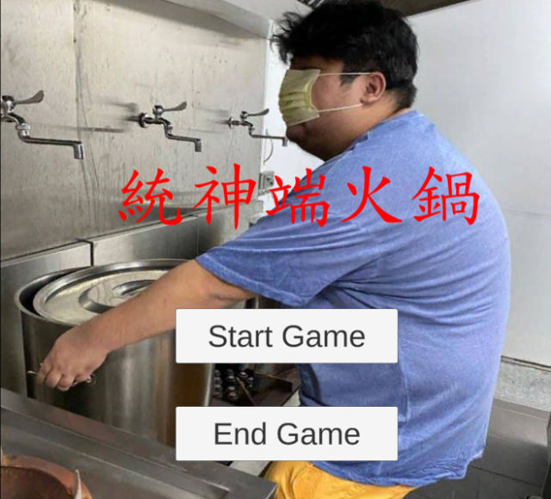
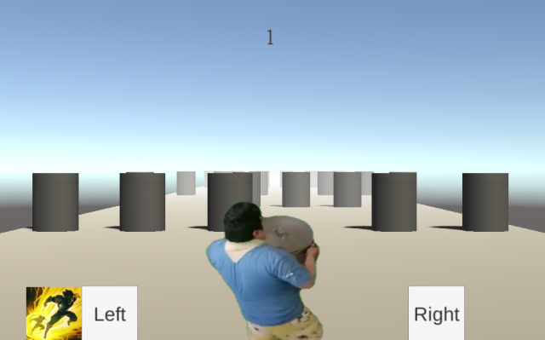
Last Class
Unity
統神端火鍋

Slide 5
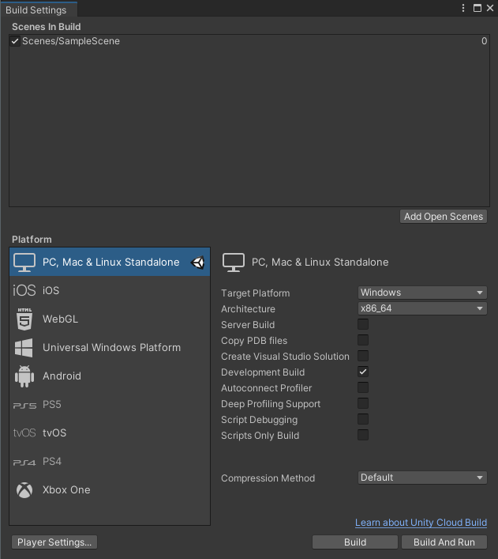
Last Class
FPS (frame per second)
Different platforms have different computing power and different FPS
It’s why we need to use Time.deltaTime in Update()

Slide 6
Last Class
FPS (frame per second) (happy math time)
movingSpeed = 10f;
transform.localPosition += movingSpeed * Time.deltaTime * Vector3.forward;
In 60 fps (maybe in PC platform)
Per Update event：10 * (1/60) * (0, 0, 1) = (0, 0, 1/6)
Per second：(0, 0, 1/6) * 60 = (0, 0, 10)
In 30 fps (maybe in Unity Editor)
Per Update event：10 * (1/30) * (0, 0, 1) = (0, 0, 1/3)
Per second：(0, 0, 1/3) * 30 = (0, 0, 10)

Slide 7
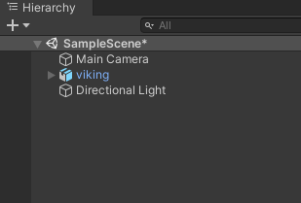

Last Class
White ??
Blue ??
Notes:
政治有分顏色難道 unity 也有嘛 !?!?

Slide 8
Outline
Prefab

Slide 9
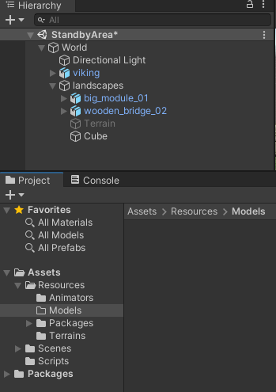
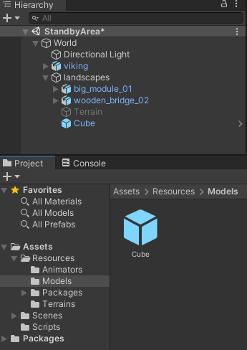
Prefab
Make a Prefab (prefabricated object)
Blue text
Prefab instance
Drag
Prefab Asset
Notes:
沒有把 GameObject 拉近 Assets ?? 算說對一半…吧 ??
GameObject 只要是生於實體檔案(存在於硬碟、資料夾內)的，在 hierarchy 中都會顯示成 blue text，也是 Prefab instance
Prefab instances are shown in the Hierarchy in blue text
Prefab system (new)
prefab Assets (created by unity editor) & model prefab (model，ex: .fbx, .dae, .dxf, .obj)
This process of creating the Prefab Asset also turns the original GameObject into a Prefab instance
model prefab
預設不支援 .ma, .md, .max, c4d, .blend 是因為要開啟，電腦都必須有相應的軟體，
故上述檔案應透過相應軟體轉成 .fbx 等通用格式

Slide 10
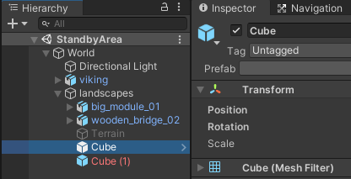
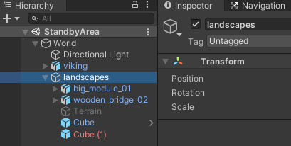
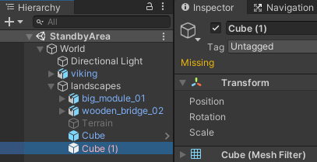
Prefab
Prefab Asset and (prefab) instance
The text of Prefab instance is blue
The text of Prefab instance missing the connection to its Prefab Asset is red
The text of others is black
Notes:
人與人之間的連結

Slide 11
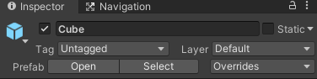
Prefab
Prefab instance
Open
Open its Prefab Asset with Prefab Mode
Select
Show its Prefab Asset in Project window
Notes:
講這麼多 prefab ，是為了甚麼 ?? 有甚麼好處 ??
An overridden property value on a Prefab instance always takes precedence over the value from the Prefab Asset.
Overriding the value of a property
Adding a component
Removing a component
Adding a child GameObject
例外：該 instance 的 prefab 是 model prefab 時，無法使用 apply

Slide 12
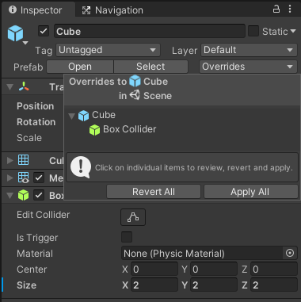
Prefab
Prefab instance
Overrides
Look over the differences between this instance and its Prefab Asset
“Revert All” would revert all its states back to its Prefab Asset
“Apply All” would apply all its overridden states to its Prefab Asset
※ Once Prefab Asset changes, all of its Prefab instance would change together
※ An overridden state on a Prefab instance always takes precedence over the value from the Prefab Asset
Overridden property
Notes:
講這麼多 prefab ，是為了甚麼 ?? 有甚麼好處 ??
An overridden property value on a Prefab instance always takes precedence over the value from the Prefab Asset.
Overriding the value of a property
Adding a component
Removing a component
Adding a child GameObject
例外：該 instance 的 prefab 是 model prefab 時，無法使用 apply

Slide 13
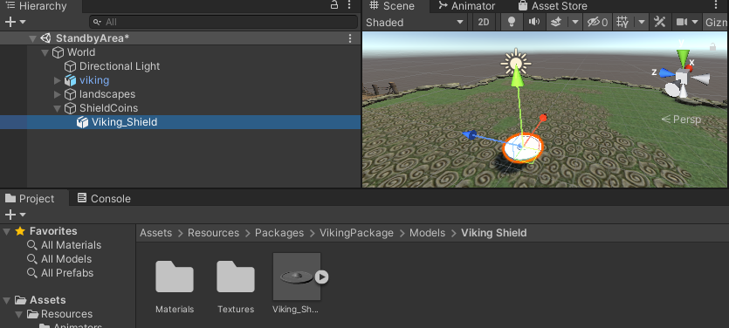
Prefab
Use the model prefab from the package
Drag

Slide 14
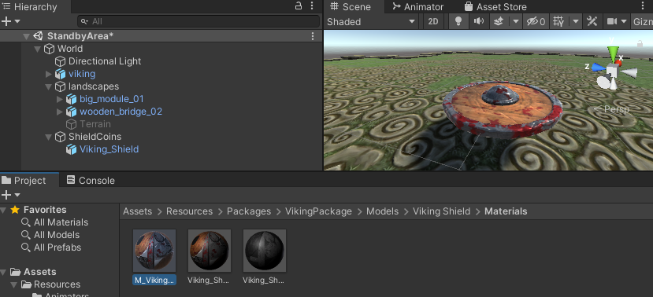
Prefab
Use the model prefab from the package
Use the materials (including textures) on model
Drag

Slide 15
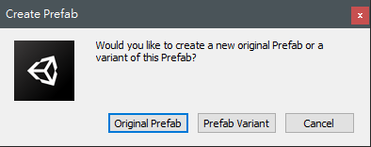
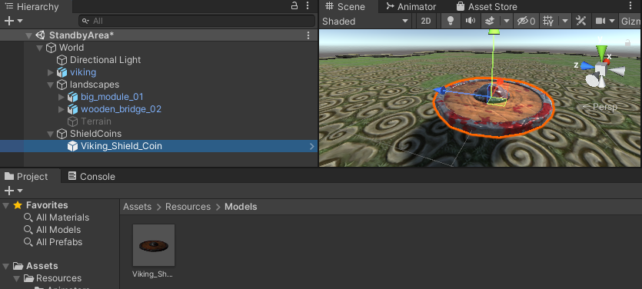
Prefab
Make it as a new Prefab Asset
Drag
Notes:
請付費解鎖 Prefab Variant

Slide 16
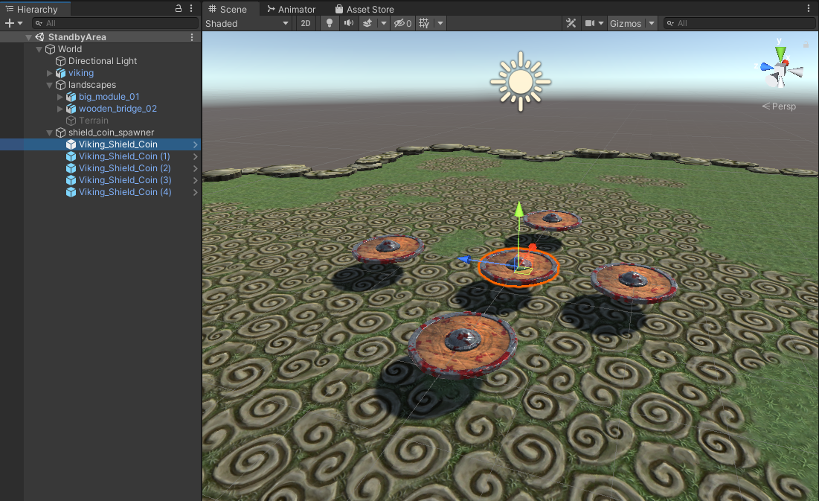
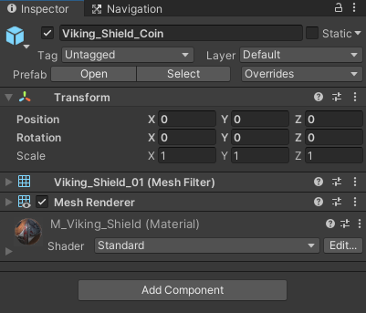
Prefab
Override
origin

Slide 17
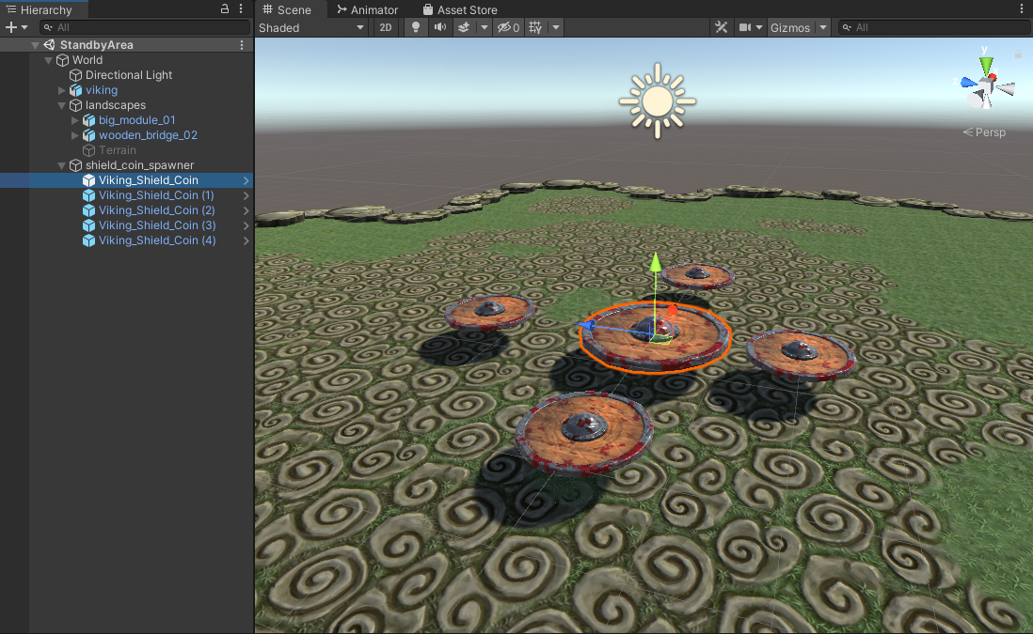
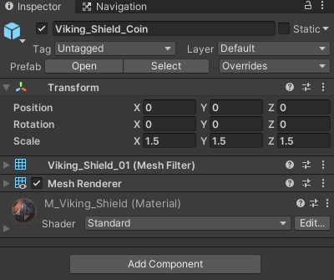
Prefab
Override
Scale up one of shield coin

Slide 18
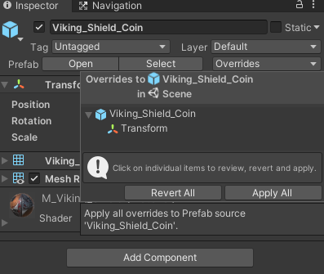
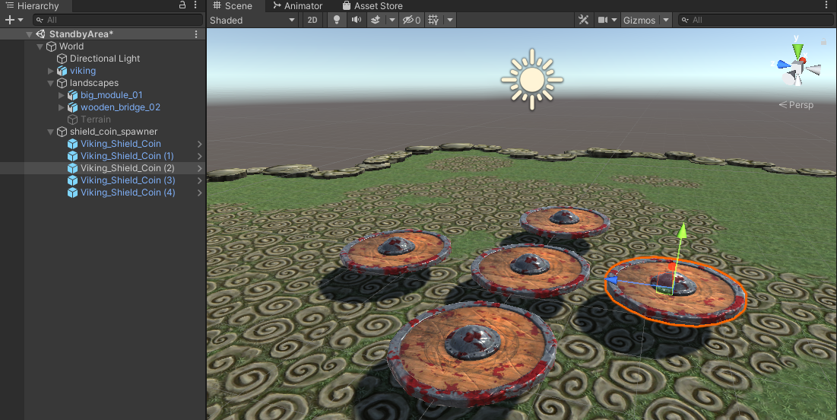
Prefab
Override
Apply the overridden property to all of Prefab instances

Slide 19
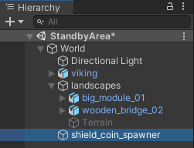
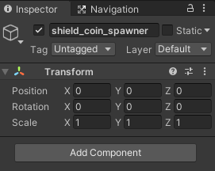
Prefab
“instantiate” Prefab instance in run time

Slide 20
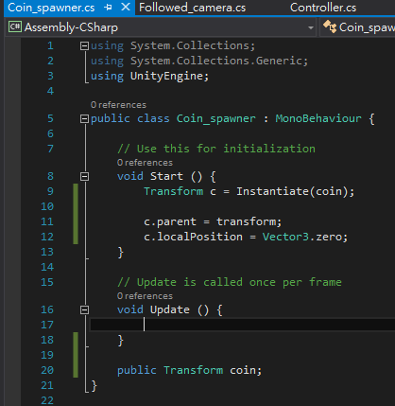
Prefab
Use “instantiate” to create a coin in run time

Slide 21
Practices
Make a shield coin as a prefab and create it with instantiate

Slide 22
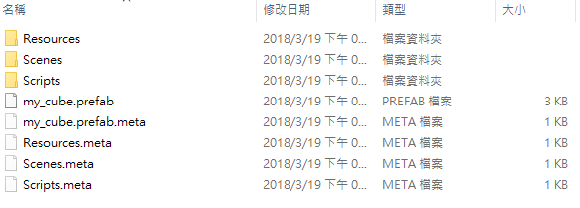
Introduction
Meta file

Slide 23
Outline
Physics

Slide 24
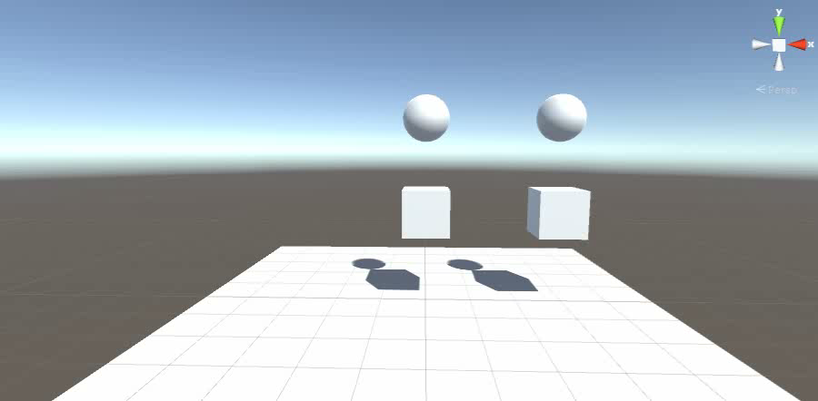
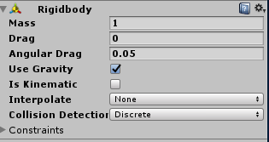
Physics
多一頁要講 physics 的緣由
Notes:
多一頁要講 physics 的緣由

Slide 25
Physics
Rigidbody

Slide 26
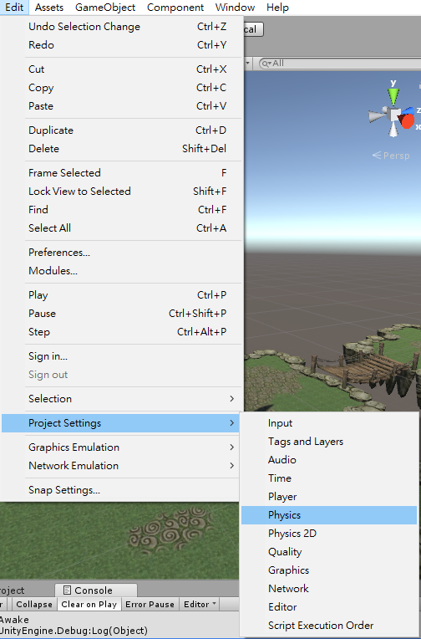
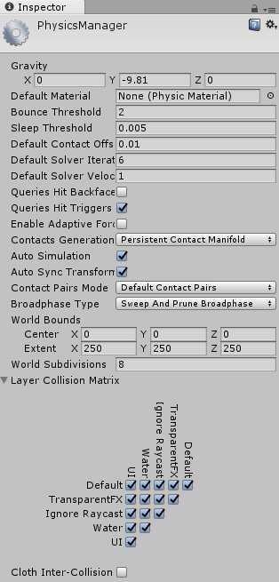
Physics

Slide 27
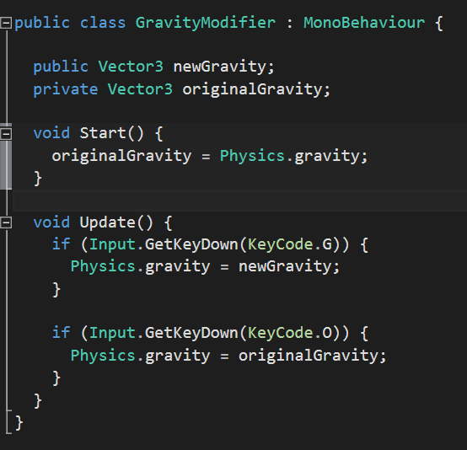
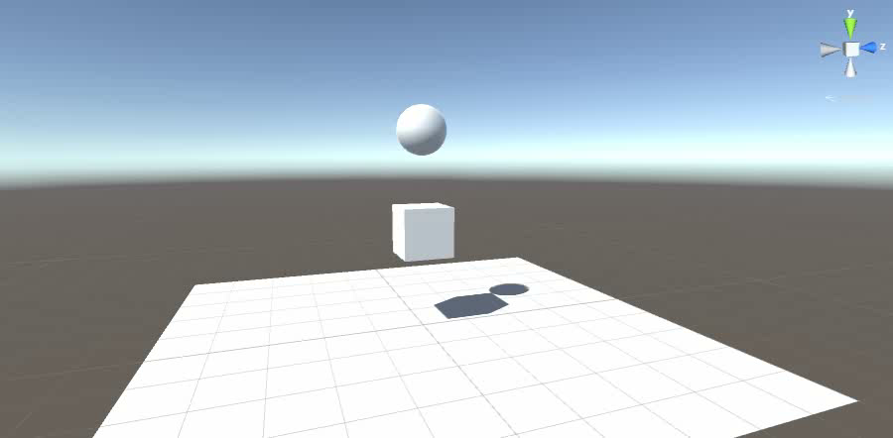
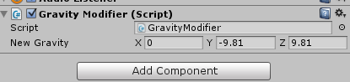
Physics
Modify gravity

Slide 28
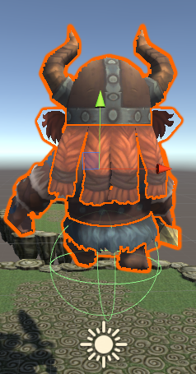
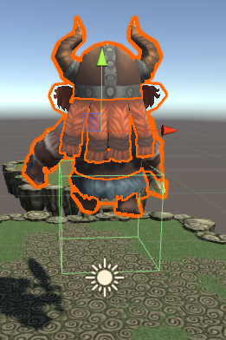
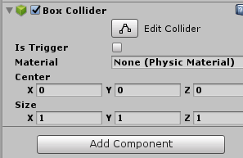
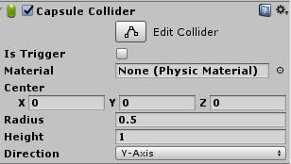
Physics
Collider

Slide 29
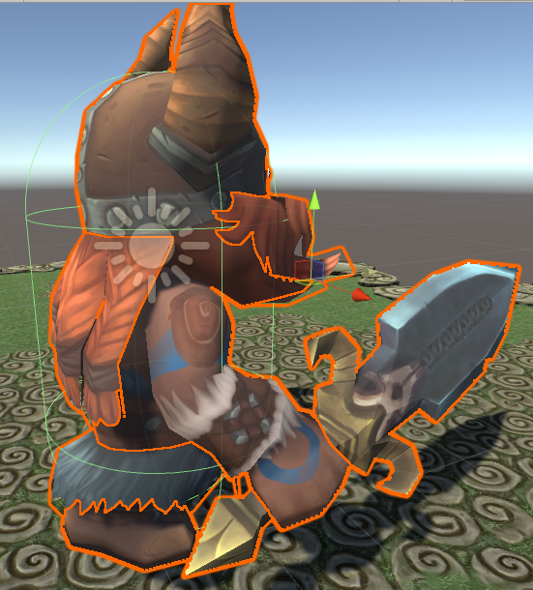
Physics
Collider

Slide 30
Practices
fit your Viking model with a capsule collider

Slide 31
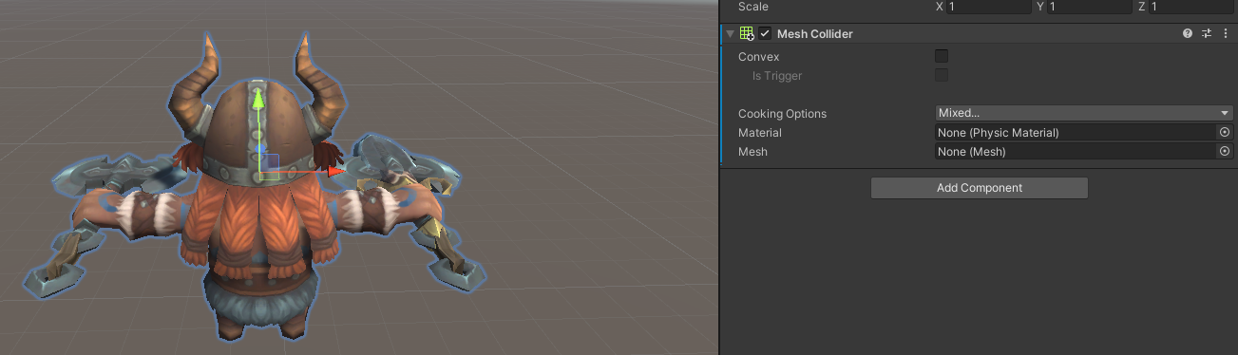
Physics
Mesh Collider
Intuitive
High-resource and unstable

Slide 32
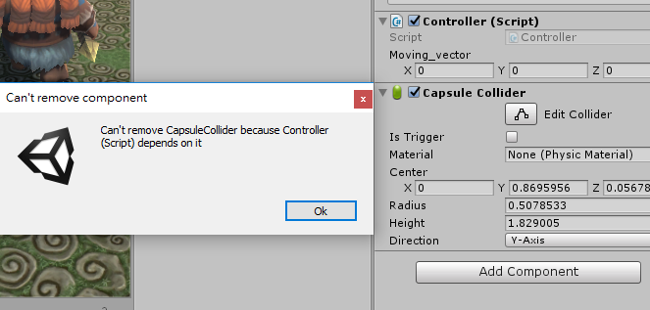
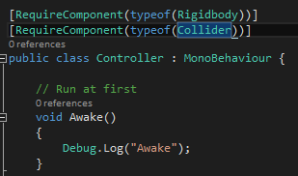
Physics
RequireComponent

Slide 33
Physics
Collision
OnCollisionEnter
OnCollisionStay
OnCollisionExit

Slide 34
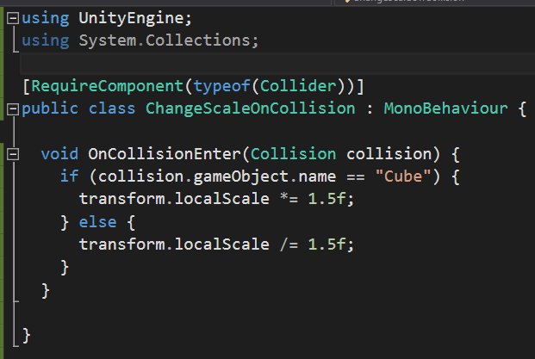
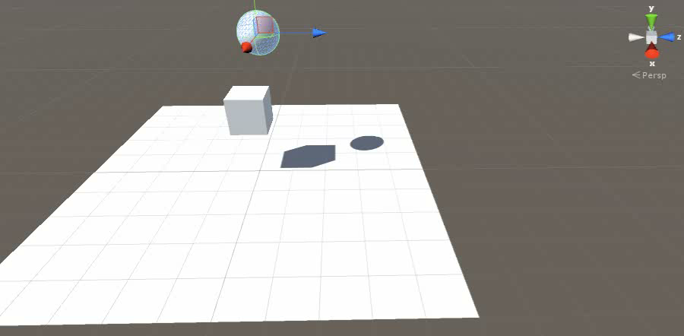
Physics
OnCollisionEnter
Ensure whether the function name of that event is correct!

Slide 35
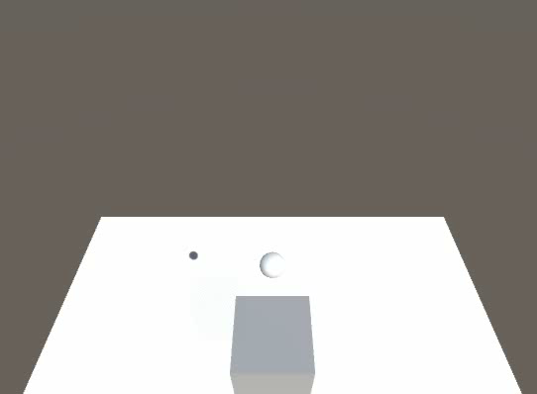
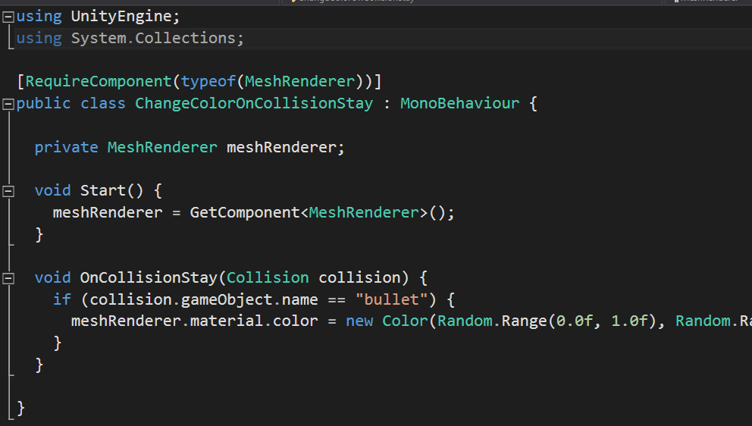
Physics
OnCollisionStay
bullet : is kinematic
box : freeze position constraint
Notes:
Kinematic 運動學的

Slide 36
Practices
Use the collision function to detect whether the player is on ground

Slide 37
Physics
Trigger
OnTriggerEnter
OnTriggerStay
OnTriggerExit

Slide 38
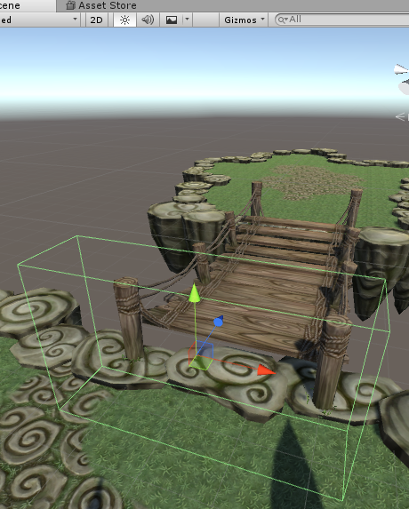
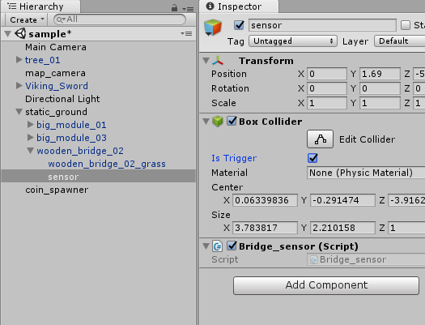
Physics
Trigger
Notes:
這種雖然感覺到卻碰不到的，像甚麼 ?? 像極了愛情

Slide 39
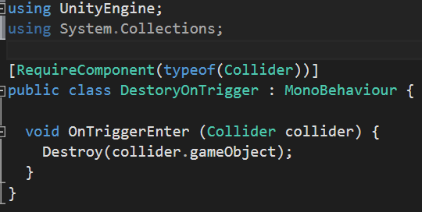
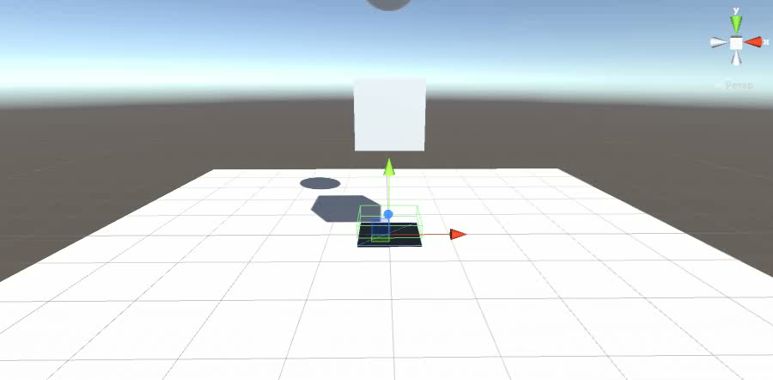
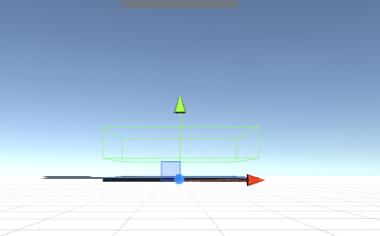
Physics
OnTriggerEnter

Slide 40
Practices
Use the trigger function to detect whether the player reaches the goal

Slide 41
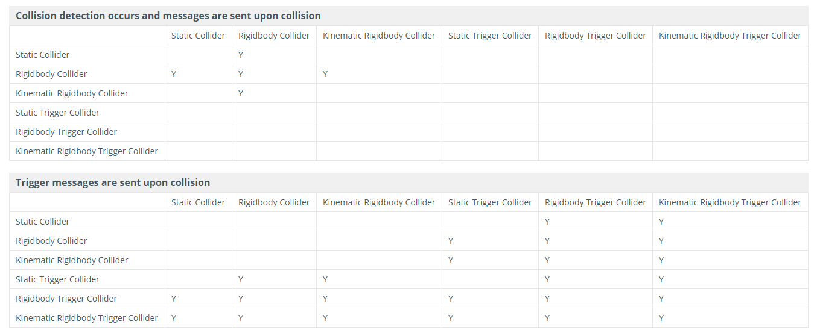
Physics
Colliders action matrix
http://docs.unity3d.com/Manual/CollidersOverview.html

Slide 42


Physics
Rigidbody – constraints

Slide 43
Practices
Use the constraints to make your player upright when running

Slide 44



Physics
Add force

Slide 45



Physics
Add torque

Slide 46


Physics
Rotated coin

Slide 47
Practices
Make the shield coin rotate continuously

Slide 48


Physics
Rigidbody – kinematic
Notes:
kinematic 運動學是力學的分支。它專門描述物體的運動，就是物體在空間中位置隨時間的變化，而不涉及力和質量等等那些造成運動的因素。明顯不同的， dynamic 動力學研究力和因為力地作用在物體上而產生的運動。

Slide 49
Physics
Rigidbody – kinematic
Forces / collision and some physics will not affect the rigidbody
Moving kinematic objects by your own code

Slide 50
Practices
Move the kinematic object by your own code

Slide 51


Physics
Raycasting

Slide 52



Physics

Slide 53


Physics
Raycasting

Slide 54


Physics
Raycasting
Destroy the coin when it is clicked by the mouse

Slide 55
Practices
User can use mouse to delete a shield coin with a left click

Slide 56


Practices
Move your player to the position where your mouse clicks by left mouse button
ray_cast_hit.point
Vector3.Distance

Slide 57

Physics
What else can ray do ?
Notes:
加個鬼滅

Slide 58


Physics
What else can ray do ?
Notes:
換成 APEX

Slide 59
Outline
Multiple Scenes

Slide 60

Multiple Scenes
Menu

Slide 61


Multiple Scenes
Create a new scene

Slide 62


Multiple Scenes
Build Settings
Click to add the active(current) scene

Slide 63

Multiple Scenes
Make scene in build
Scene index
Activate “menu”

Slide 64


Multiple Scenes
Menu scene
Notes:
提一下 canvas 的概念

Slide 65


Multiple Scenes
Menu scene

Slide 66

Multiple Scenes
Menu scene

Slide 67


Multiple Scenes
Menu scene

Slide 68

Multiple Scenes
Menu scene

Slide 69

Multiple Scenes
Start button script
To use those interface
Button click interface
Button click function
To use the “SceneManager”
Go to the scene 1

Slide 70
Multiple Scenes
When you go to other scene, those gameobject in the current scene would be destroyed
If you want to preserve some gameobjects, please use “DontDestroyOnLoad”

Slide 71


Multiple Scenes
Notes:
Canvas mix 2D & 3D

Slide 72

Multiple Scenes
Exit the game

Slide 73
Practices
Create a new scene as your game menu

Slide 74

Multiple Scenes
If your scene get darker when a scene changes to another scene, please take http://answers.unity3d.com/questions/918371/models-get-much-darker-when-switching-levels-but-a.html as reference
It occur only in editor mode

Slide 75


Multiple Scenes
Disable “Auto”
Click !

Slide 76





Multiple Scenes
Why doesn’t Pokemon Go design a menu only ??
Why do we need Menu ??
Notes:
為什麼大部分的遊戲都有 menu ，但 pokemon go 卻沒有 ??
為什麼像動森，最一開始點擊時就直接跳到教學頁面而沒進 menu ??

Slide 77


Multiple Scenes
Merge your practice and homework!
Copy it!

Slide 78


Multiple Scenes
Merge your practice and homework!
※The same name of the scripts will cause error!
Copy it!

Slide 79




Multiple Scenes
Correct the script name!
※Change both the script name and class name

Slide 80
Outline
Game (Program) Logic Practice

Slide 81
Game (Program) Logic Practice
Not only your codes but also all of your
Documents
Art works

Slide 82
Homework
Viking game
Randomly generate some shield coins
A game menu which can start your game and exit your application
Your game scene must has the capability of coming back to your game menu
Game logic for VikingRun (TempleRun)

Slide 83
Outline
Next Class

Slide 84



Next Class
炎姬
炎姬_宣傳

Slide 85


Outline
Thank you for your listening!

